Slide 1



Duffy Health Center
Draft FY 2025 Budget and Key Assumptions
Finance Committee and Board Presentation
June 3, 2024

Slide 2
FY 2025 PATIENT SERVICE REVENUES
The makeup of patient service revenue is as complex in FY 2025 as it was for FY 2024 for the Duffy Health Center.
Duffy’s agreement through the Community Care Collaborative (C3) for Medicaid sub capitation started on 4/1/2023. It is a Medicaid primary care program which reimburses global payments of $94.42 per member per month. The total amount may vary monthly depending on the number of enrollees. For FY 2025 we have budgeted to assume a monthly enrollment of 1,470 members per month or $1,675,800 per year.
As of 1/1/2023 the Duffy entered a global payment arrangement via C3 called REACH with Medicare that reimburses the Duffy a projected $38.80 per member per month for both medical and behavioral health patients for FY 2025. The total amount received will also vary monthly depending on the number of our enrollees. Substance use disorder and medically assisted treatment patients are carved out. Those patients carved out will be reimbursed at the Medicare fee for service (FFS) rates.
Medicaid Behavioral Health patients continue to be reimbursed on a FFS basis and the Duffy will also continue to receive a ‘wrap’ payment representing the difference between historic PPS rates and newly negotiated APM rates with the Commonwealth of Mass.

Slide 3
FY 2025 PATIENT SERVICE REVENUES: Continued
As has been discussed at Finance Committee, we have applied to MassHealth for changes in scope to account for our increased operating costs related to the expansion of our substance use disorder programs and the implementation of our EPIC EHR. If approved, the amounts to be received via the quarterly wrap payments for our FFS patients could be increased to @ $267 from $241 at present. The 2025 budget does not assume this increase as it is likely we will hear from MassHealth in late June/early July.

Slide 4
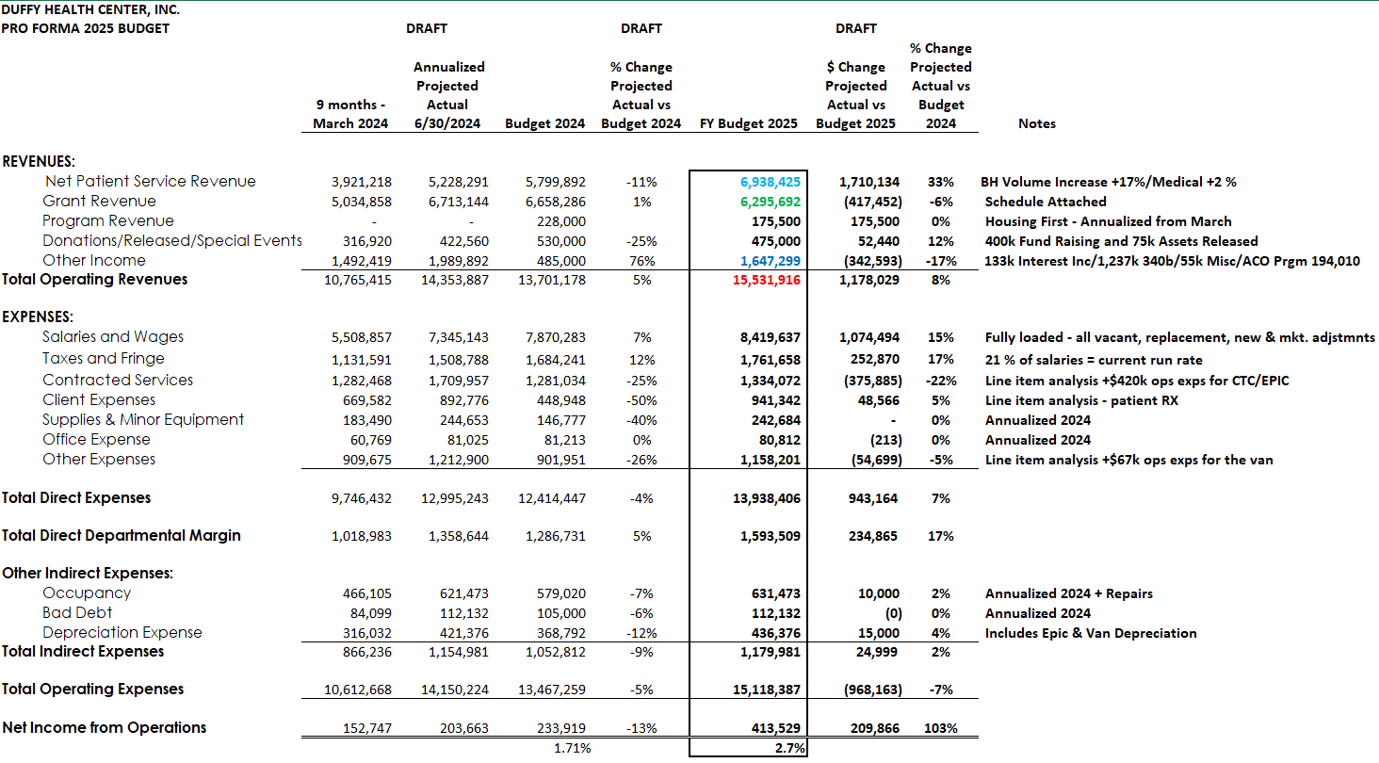

Slide 6
 |  |  | NOTES
Member months - Portal | 17,640 |  | Portal member months
Rate CY 2024 | 95.00 |  | Projected rate
Medicaid Medical Capitation |  | 1,675,800
FFS | 7,523
Rate FY 2024 | 241 |  | Without CIS
Medical FFS |  | 1,833,756
Medicare Reach | 4,747 |  | Portal member months
Rate CY 2024 | 38.80 |  | Projected rate
Reach |  | 184,184
Behavioral Health | 12,700
Rate CY 2024 | 241 |  | Without CIS
BH FFS |  | 3,060,700
Tier | 17,640
Rate CY 2024 | 10.43 |  | Projected rate
 |  | 183,985
Total Patient Service Revenue |  | 6,938,425

Slide 7
Patient Service Revenue
Medical Service Volume Assumptions
Two MD’s
Our CMO, Dr. Lisa Jones, was hired September 2022. Eighty percent of her time is dedicated to administrative functions. The FY 2025 budget assumes 20% of her time will be dedicated to patient care activity and assumes the CMO will perform 500 visits.
Our long-standing MAT MD, Dr Lisa Zandonella-Huhta has scaled back her hours and is assumed to treat a volume of 700 MAT visits.
No new MD volume related to a new MD hire is assumed in the FY 2024 budget.
Five Mid levels
The budget includes volumes related to five medical mid levels. Two new Medical NPs were recruited in FY 2023. The 2025 budget includes three experienced full time midlevel providers with budgeted visits of 1,900 visits per provider. Two of the mid levels will be out of office for 2 and 6 months respectively and their expected volume is adjusted accordingly. The incentive program will compensate for volume achieved more than the budgeted goals. Total midlevel budgeted volume assumed for the year is 8,407.
Behavioral Health
The budget assumes 11 total behavioral health providers comprised of: 1 full time psychiatrist completing 1,600 visits; 3 full time Psych NP’s with one NP budgeted at 1,600 visits and two newer Psych NP’s budgeted at 1,200 each; 6 full time therapists with volume targets of 1,250 visits for 3 of the therapists. Two therapists are embedded in the patient care teams with 520 visits assumed for a newcomer and 780 visits assumed for a more experienced embedded therapist. One brand new therapist is assumed to treat 800 patients inclusive of ramp up time.

Slide 8
OBOT/MAT, Nursing and Nutrition
The budget assumes 3 OBOT/MAT nurses. Two nurses are full time and are budgeted to achieve 1,600 visits. One nurse is budgeted at 900 visits per year.
Other nursing visits are budgeted at 600 chargeable visits in total.
We are required to provide nutrition services under our Medicaid contract, and we have budgeted FY 2025 to achieve 50 visits mirroring actual volume in FY 2024.
Incentives
The 2025 budget assumes $50,000 in incentive pay for our providers; and $108,000 for an annual entity-wide ‘profit-share’ contribution.
Rates
Reimbursement rates for fee for service medical visits inclusive of mid levels/OBOT/MAT and nursing are assumed to be reimbursed at $241 per visit including the wrap. Behavioral health therapist, psychiatry and psychiatric NP’s visit rates are assumed to be reimbursed at $241 per visit including the wrap.

Slide 9
Grant Revenue
HRSA 330H
Duffy’s Service Area Competition (SAC) grant application was approved for three years on 1/12/2023. The grant term runs from 4/1/2022 to 3/31/2025. The budget assumes $2,684,289 in HRSA grant revenues for FY 2023-2024. This grant is the bedrock of Duffy’s existence. The SAC award now includes what were previously stand-alone awards related to SUD (substance use disorders) and IBH (integrated behavioral health services).
A copy of our Non-Competing Continuation budget submission for FY 2024 that was submitted for our 330h budget is included in this Board budget package.
Other Grants:
SAMHSA: An annual award of $525,000 will continue in FY 2025.
Housing First: The budget assumes $175,500 of funding from the Commonwealth of Mass.
CCHC: The budget assumes continued funding from CCHC for support of our psych program at $60,000 per year and support for the In from the Streets/Medical Respite program at $65,000.
Welcome Home: The total amount budgeted is consistent with prior years at $174,403.
Moms Do Care : The Moms do Care grant continues for FY 2025 totaling $500,000.
ARP Capital: Residual Arp Capital funds totaling $105,000 will support our retina evaluation program; improvements to internal and external security for our facility and the completion of the three-year IT capital investment program.
DPH OBOT Grant: The budget includes $180,000 of continued funding from the Commonwealth for our Medication Assisted Treatment program.
Mass State Opioid Response (SOR-3): This grant will continue into FY 2025 in an amount of $300,000.

Slide 10
Grant Revenues Continued..
Alternative Peer Group: the APG budget assumes its continuance in FY 2025 in the amount of $295,000.
APG – BHI: The support from Behavioral Health Innovators continues in FY 2023 in the amount of $80,000.
Towns: the budget assumes $13,200 in support from Chatham, Orleans, Harwich, Yarmouth, Sandwich, and Brewster. Yarmouth contracted for the services of Recovery Support Navigators in the amount of $15,000 for FY 2025.
Community Health Worker (CWH) Grant: Via the Mass League, a grant for $140,000 will fund two community health workers focused on population health.
ESG – “3”: Duffy received $417,244 in Emergency Shelter Grant funds in FY 2024. The Budget assumes a similar amount of support in FY 2025. The budget also includes a similar amount of operating expense.
In the Pipeline: Given the Duffy track record it is highly likely more grant funds will flow to 94 Main Street in FY 2025.
No assumptions, however, have been made for grant funds yet to be awarded in the FY 2025 budget. There are known grants as of 6/1/2024 in which Duffy is interested and to which will likely be making successful application(s).

Slide 13
Donations and Other Income
Donations/Assets released/Special Events
Donations and assets released from restrictions are budgeted at a total amount of $475,000. Donations assumed of $400,000 represents a decrease of $55,000 over FY 2024. Funds released from restrictions are budgeted at the same level as FY 2024 and FY 2023 at $75,000. ROAR funds of $15,000 are budgeted in FY 2025 donations as well. With a new Chief Development Officer coming on board, we budgeted an amount similar to prior years and assumes a similar special event.
Other Income
Other income totaling $ 1,647,299 includes gross revenues of $1,237,000 related to the 340b drug program (program expenses are reported under client expenses and other expenses); estimated income related to investment interest of $133,810 resulting from our $2.0m investment in laddered 3- month certificated of deposits and our sweep accounts; ACO program payments of $194,010 and includes medical records fees, Medicare cost report settlements of $23,000 and other miscellaneous income totaling $55,000.

Slide 14
 | OTHER INCOME
 | Interest income |  | $ 133,810
 | Miscellaneous |  | $ 82,416
 | 340b Gross income |  | $ 1,237,063
 | ACO Program Income |  | $ 194,010
 |  |  |  | $ 1,647,299

Slide 15
Duffy Health Center
FY 2025 Budgeted Expenses
Salaries and Wages:
Total salaries are budgeted at $ 8,419,637. The budget assumes a 3.0% rate increase for all employees effective 9/1/2023 (effectively a 2.5% increase for FY 2024). Salary expense is fully loaded and includes the cost of vacant, replacement and proposed new positions. Salary expense includes year end profit-sharing and provider bonuses. One new FTE is being requested.
Taxes and Fringes:
Fringe benefits are budgeted at 21% (actual cost % at 4/30/2023) of salaries and wages = $1,761,658.
Contracted Services:
Contracted services have been budgeted based on actual expenses/run rate through March 2024 and total $1,334,072 Non-grant related services include the payroll service, the nutritionist, the interpreter service, marketing/PR consults, legal costs, billing and audit services. The contract service for the outsourced IT network support, Secure Networks, is budgeted at $300,000. Expenses for our new EPIC EMR is budgeted at $420,000. The outsourced billing service is budgeted at $290,000. Expenses for consulting services related to referrals and temp help for the front desk are assumed not to re-occur in FY 2025 and account

Slide 16
For the overall decrease in contracted services year over year.
Client Expenses:
Client expenses are budgeted at $941,342. Client expenses include those items that support our patients in their care and have been budgeted based on actual expenses/run rate through 3/31/2024. Major client expenses include 340b drug costs of $551,000 and transportation costs of $113,000. The HUD rent payments to support client housing are budgeted for $167,000.
Occupancy:
Occupancy costs have been budgeted at the current run rate through 3/31/2024 which includes the leased space at 94 Main street and rent expense for 69 Camp street, and offices in Falmouth and Dennis for Moms Do Care and APG BSAS. The costs include rent, utilities, repairs and maintenance and total $631,473.
Office Expenses:
Office expenses are budgeted at the current run rate through 3/31/2022 at $80,812. Most of the expense is comprised by land lines, Ring Central services and cellular telephone expenses for staff and 94 Main street. A small balance is postage.

Slide 17
Other Expenses:
Other expenses include miscellaneous costs such as insurance coverage for cybersecurity, D&O, property and malpractice gap programs. The costs for meals, meetings, travel, recruitment, special events, dues, subscriptions, licenses, education, and entertainment/gifts are all booked to ‘Other Expense’. The dispensing fees and administrative costs related to the 340b program are booked to ‘Other Expenses’. Expenses related to the delivery of our cold weather and medical respite programs such as motel room rentals, meals and security services are booked to ‘Other Expense’ as well. Many of these costs are covered by offsetting grant revenues.
Bad Debt:
Bad Debt expense is budgeted at $112,132 or @1.6% of NPSR. This amount mirrors FY 2024 projected year end. However, with eCW accounts receivable wound down and our transition to global payments in full swing, we are less exposed to third party payer or patient collection risk. Given the expertise of the outsourced billing company and the Duffy’s renewed emphasis in the EPIC implementation on eligibility and tight workflows in our the front-end we are predicting that, overall, bad debt expense should trend south over time.
Depreciation:
Depreciation has been budgeted at the actual expense/run rate as of 3/31/2024 with additional expenses + 15,000 in anticipation of further investment in software and hardware. EPIC EMR and the mobile shower/outreach health van. The EPIC project is being depreciated over 7 years and the mobile van over 5 years.

Slide 20
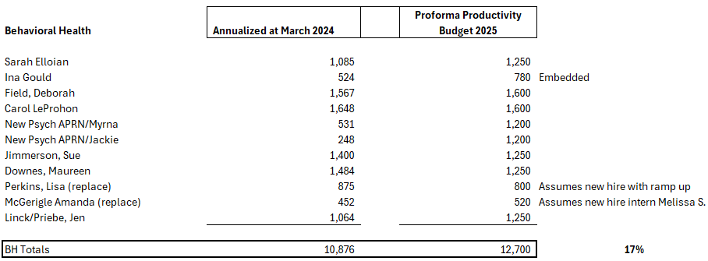

Slide 21
Projected 340b Net Income

